Slide 1

23AID305: Control System
Project Title: Energy Management System for Renewable Energy-Based EV Charging Station Using Fuzzy Logic, PID
Team - 17
Dheeraj Doma – [CB.AI.U4AID23007]
Kota Kedhar Nath - [CB.AI.U4AID23015]
M Sai Krishna - [CB.AI.U4AID23020]
Molakalapalli Rishitha- [CB.AI.U4AID23023]

Slide 2
Introduction
Increasing global demand for clean, sustainable energy has accelerated the adoption of renewable sources like solar and wind.
Hybrid Renewable Energy Systems (HRES) offer enhanced reliability for standalone applications by combining multiple intermittent sources.
The core challenge lies in the volatility of power generation, which creates a mismatch between supply and demand.
An intelligent Energy Management System (EMS) is therefore essential to balance power flow, manage energy storage, and ensure a stable supply to the load.

Slide 3
Literature Review
SI NO | Title | Year | Methodology | Key Contributions
1 | Secure-Enhanced Federated Learning for AI-Empowered Electric Vehicle Energy Prediction | 2025 | Lightweight Authentication FL | Enhanced security with premium-penalty mechanism for EV energy prediction.
2 | Energy Management System for Hybrid Renewable Energy-Based Electric Vehicle Charging Station | 2023 | Fuzzy Logic with proposed FL extension | Achieved 74.67% cost reduction, proposed FL for scalability and privacy.
3 | Data-Driven Energy Management of an Electric Vehicle Charging Station Using Deep Reinforcement Learning | 2024 | Deep Reinforcement Learning (DRL) with FL suggestion | Minimized operating costs, suggested FL for distributed privacy.
4 | A Multiagent Federated Reinforcement Learning Approach for Plug-In Electric Vehicle Fleet Charging Coordination | 2024 | Multiagent Federated RL | Enabled scalable, privacy-preserving coordination for renewable-integrated fleets.

Slide 4
5 | Energy Demand Forecasting for Electric Vehicles Using Blockchain-Based Federated Learning | 2024 | Blockchain + FL | Reduced communication latency and improved load balancing for renewable stations.
6 | Federated Learning-Based Prediction of Energy Consumption from Blockchain-Based Black Box Data for Electric Vehicles | 2024 | Blockchain + FL | Secured data management and grid stability for renewable energy optimization.
7 | Reinforcement Learning for Electric Vehicle Applications in Power Systems: A Critical Review | 2024 | Review with FL integration suggestion | Proposed FL for dynamic renewable charging, addressing privacy gaps.
8 | Hybrid Renewable Energy Fed Battery Electric Vehicle Charging Station | 2023 | Microgrid Technology with FL proposal | Suggested FL for managing distributed renewable sources in charging stations.

Slide 5
Research Gaps
Control-oriented FL: Few studies integrate FL outputs directly into hierarchical EMS controllers for real-time set-point dispatch
Multi-objective optimisation: Current FL-EMS frameworks only on few occasions co-optimise cost, grid-support and battery ageing.
Privacy vs. latency trade-off: Encryption layers raise computation times; lightweight schemes for sub-minute scheduling remain open.
Edge resource constraints: Energy-aware client selection is still prototype-level; production-grade orchestration is lacking.

Slide 6
Problem Statement
Current EMS in EV charging stations using fuzzy logic lack adaptability to dynamic changes in demand, renewable supply, and grid tariffs. They require manual rule updates and are not scalable across multiple stations.
Existing systems also raise privacy concerns by relying on centralized data collection. Hence, a privacy-preserving, adaptive, and scalable EMS is needed to optimize charging cost and renewable energy use.

Slide 7
Objectives
To model and simulate a hybrid energy system in MATLAB/Simulink, integrating:A solar PV array with a DC-DC buck-boost converter.A mathematical model for a wind turbine generator.
To implement a Maximum Power Point Tracking (MPPT) algorithm to maximize energy extraction from the PV source.
To design an Energy Management System (EMS) using a Fuzzy Logic Controller (FLC) to supervise the energy flow between the sources, battery, and load.
To analyze the system's performance in maintaining power balance and regulating the battery's State of Charge (SOC) within safe operational limits.

Slide 8
Renewable Energy Integration
Renewable energy sources are natural, sustainable, and non-polluting sources of energy that are replenished over time.
Solar : Electricity generated using sunlight, via solar panels
  Time-dependent — varies throughout the day (high in afternoon, zero at night)
  Biogas power : Electricity produced by burning biogas from organic waste
  Works via a biogas generator (like a diesel generator but cleaner)

Slide 9
Renewable energy
Wind: Electricity generated using wind energy via wind turbines.
Weather-dependent — varies with wind speed and atmospheric conditions
Formula: P = 0.5 × ρ × A × V³ × Cp (aerodynamic power equation)
Hydro Power: Electricity produced by flowing water via hydro turbines
Flow-dependent — varies with water flow rate and head height
Formula: P = ρ × g × Q × H × η (hydraulic power equation)

Slide 10
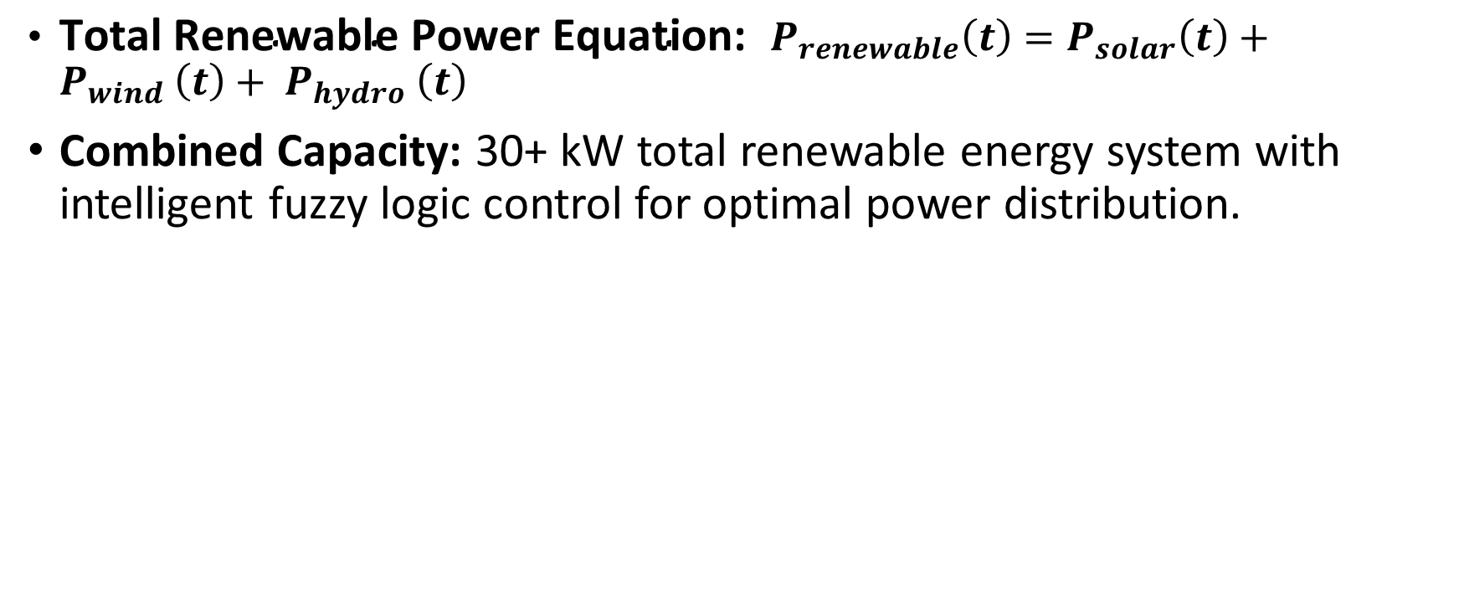
Renewable Energy
${\text{Total} \text{Renewable} \text{Power} \text{Equation}\text{: } P}_{renewable}\left(t\right)=P_{solar}\left(t\right)+P_{wind} \left(t\right)+ P_{hydro} \left(t\right)$
Combined Capacity: 30+ kW total renewable energy system with intelligent fuzzy logic control for optimal power distribution.

Slide 11
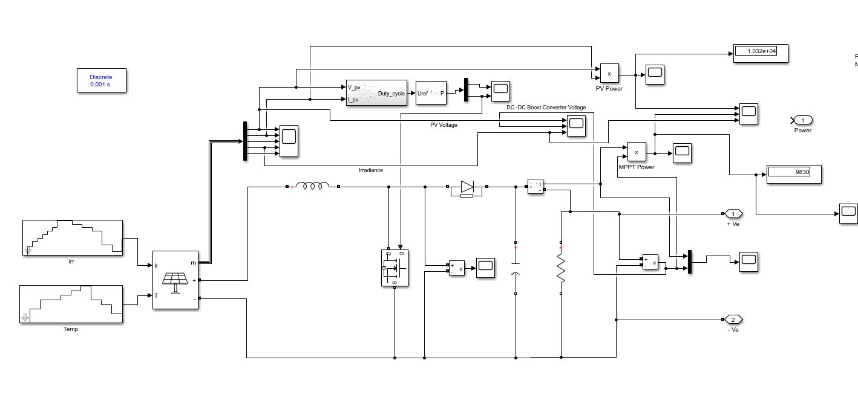
Solar

Slide 12
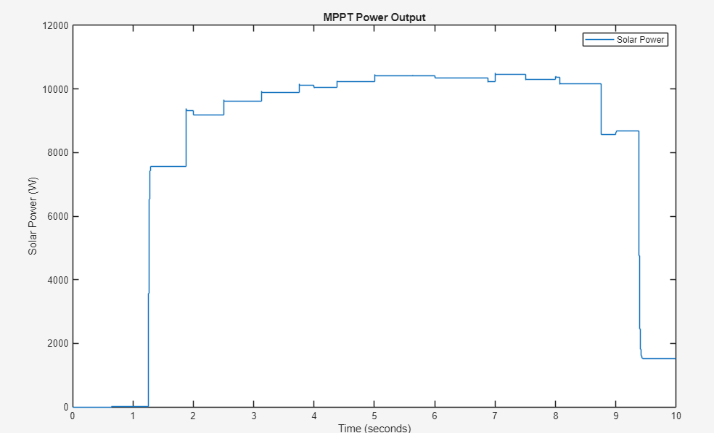
Solar

Slide 13
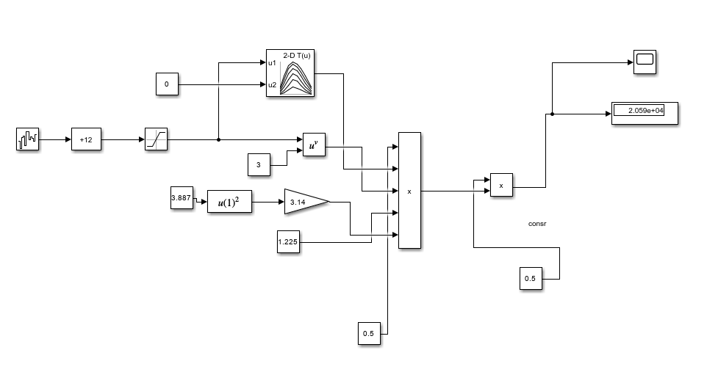
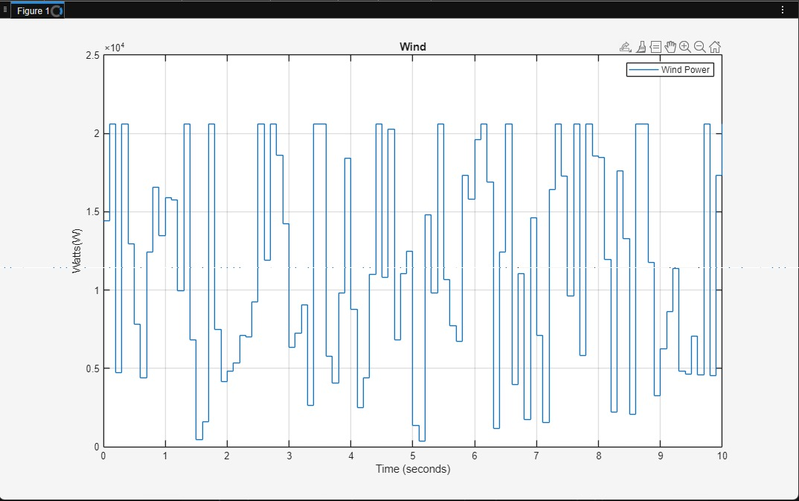
Wind
Pm​ is the mechanical power.
ρ (rho) is the air density, represented by the constant 1.225 kg/m³.
A is the area swept by the turbine blades (A=πR^2 ).
v is the wind speed.
C p​ is the power coefficient, which is a function of the tip-speed ratio (λ) and pitch angle (β).
Pm = 0.5 × ρ × A × V³ × Cp
Output: Mechanical power to Electrical Power

Slide 14
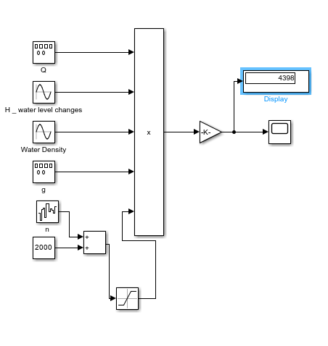
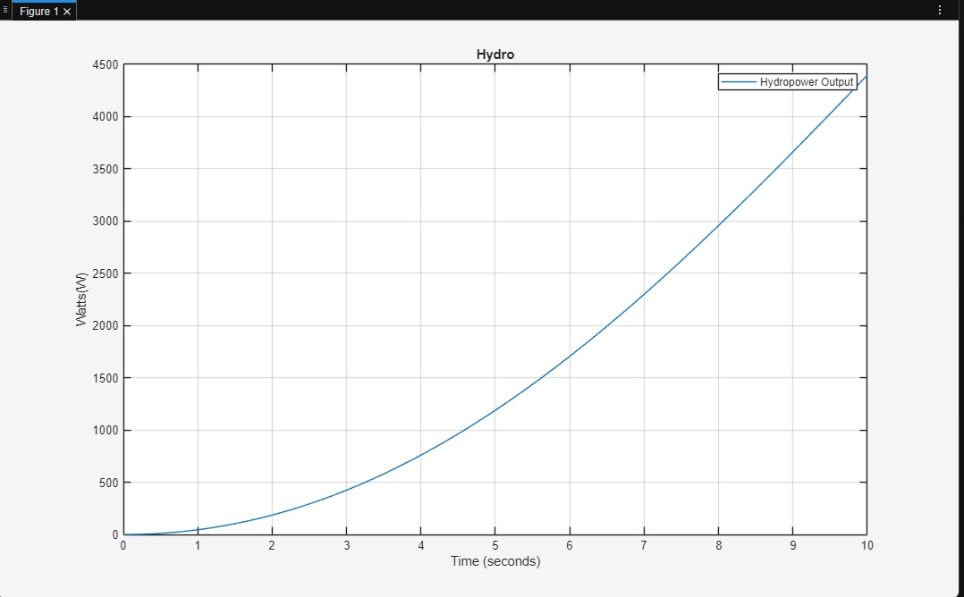


Hydro
P is the output power.
η (eta) is the efficiency of the turbine-generator system.
ρ (rho) is the water density (Water Density block).
g is the acceleration due to gravity (g block).
Q is the water flow rate or discharge (Q block).
H is the effective head (height difference).
P=η*ρ*g*Q*H

Slide 15
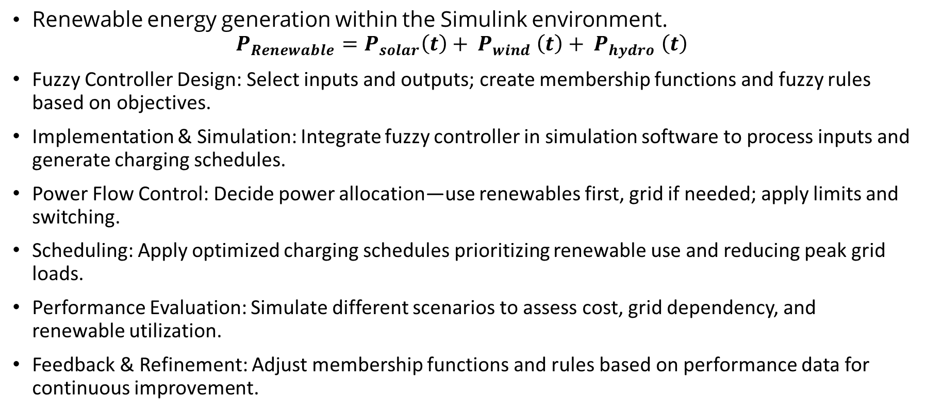
Methodology
Renewable energy generation within the Simulink environment.
$$P_{Renewable}=P_{solar}\left(t\right)+ P_{wind} \left(t\right)+ P_{hydro} \left(t\right)$$
Fuzzy Controller Design: Select inputs and outputs; create membership functions and fuzzy rules based on objectives.
Implementation & Simulation: Integrate fuzzy controller in simulation software to process inputs and generate charging schedules.
Power Flow Control: Decide power allocation—use renewables first, grid if needed; apply limits and switching.
Scheduling: Apply optimized charging schedules prioritizing renewable use and reducing peak grid loads.
Performance Evaluation: Simulate different scenarios to assess cost, grid dependency, and renewable utilization.
Feedback & Refinement: Adjust membership functions and rules based on performance data for continuous improvement.

Slide 16
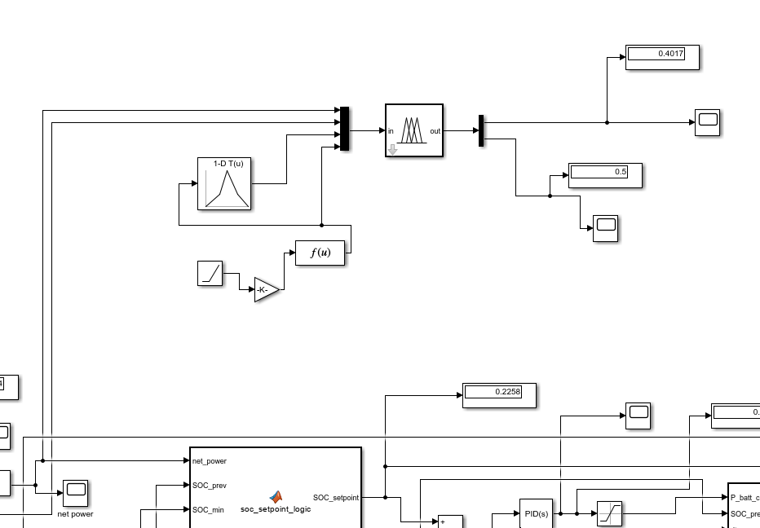
Fuzzy Logic

Slide 17
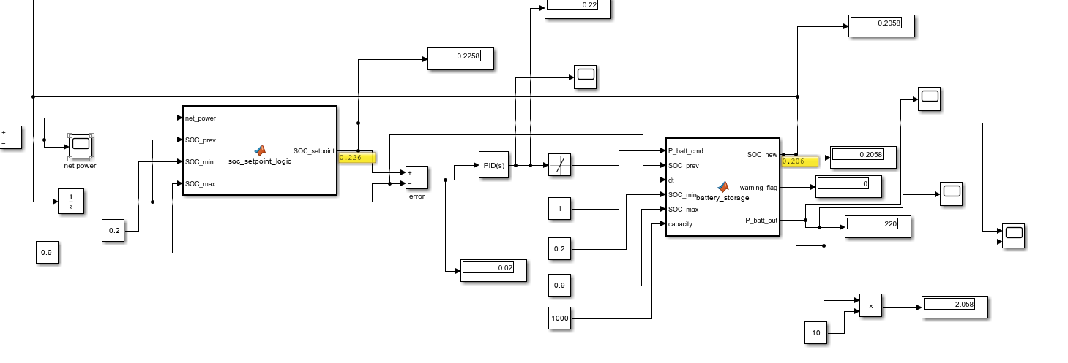
PID

Slide 18
Fuzzy Logic
Power Generation: Power is generated from the hybrid sources and is aggregated into
a total generated power signal.
Fuzzy Inputs: The fuzzy controller receives this generated power, the EV
demand_input, the Charging-Period (peak/off-peak), and the Existing-Tariff as its inputs.
Decision Making: The controller then uses its internal rules to output a dynamic
Charging-Cost and a Renewable-Utilization metric.
Power Management: Based on whether there is a power surplus or deficit, the
Switch block decides the final power flow. If there is a deficit, power is taken from the grid; if there is a surplus,
the excess can be directed to nearby residences.

Slide 19
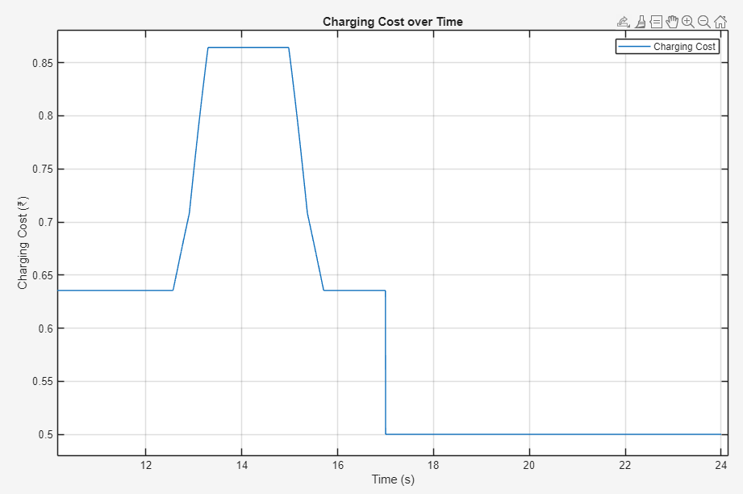
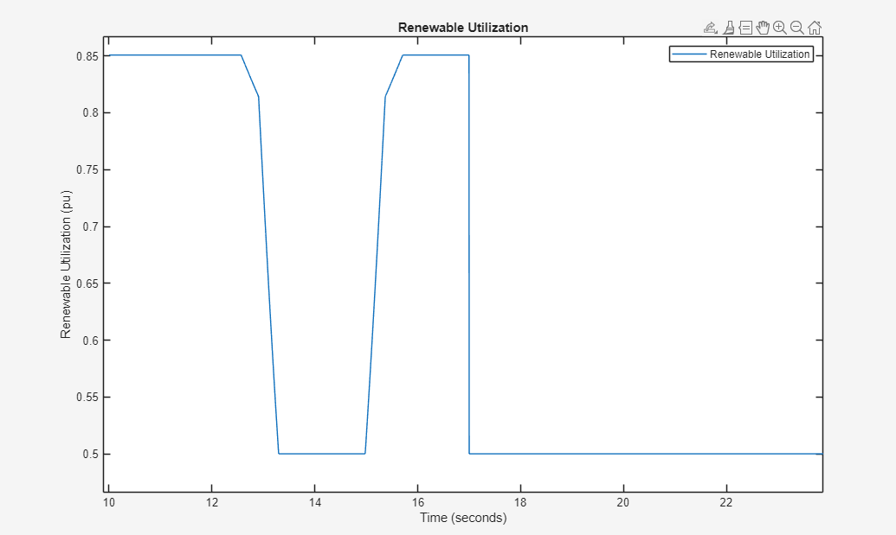
Results
Fuzzy Logic
Renewable utilization
Cost

Slide 20
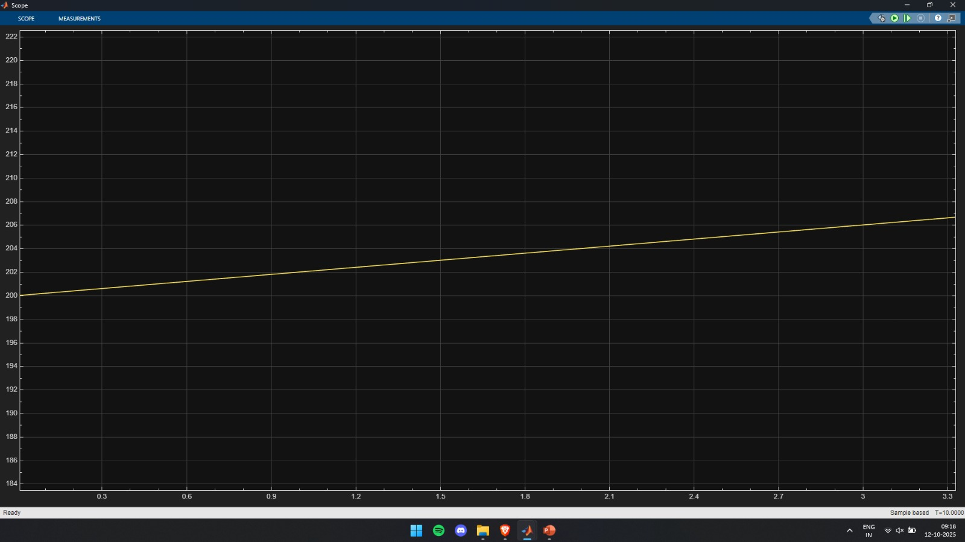
Results
PID Output
The plot mathematically proves that the controlled variable is being steadily increased due to integration of the error by the PID controller.

Slide 21
Results

Slide 22
References
[1] Y. M. Saputra, D. T. Hoang, D. N. Nguyen, E. Dutkiewicz, M. D. Mueck, and S. Srikanteswara, “Energy Demand Prediction with Federated Learning for Electric Vehicle Networks,” in *Proc. IEEE Global Communications Conference (GLOBECOM)*, Dec. 2019. Available: arXiv:1909.00907.
[2] A. K. Karmaker, M. A. Hossain, H. R. Pota, A. Onen, and J. Jung, “Energy Management System for Hybrid Renewable Energy‑Based Electric Vehicle Charging Station,” *IEEE Access*, vol. 11, pp. 27793–27805, 2023, doi:10.1109/ACCESS.2023.3259232.
[3] X. Asha *et al.*, “Data‑Driven Energy Management of an Electric Vehicle Charging Station Using Deep Reinforcement Learning,” *IEEE Access*, 2024.
[4] “Secure‑Enhanced Federated Learning for AI‑Empowered Electric Vehicle Energy Prediction,” *IEEE Consumer Electronics Magazine*, vol. 12, no. 2, pp. 27–34, Mar. 2023, doi:10.1109/MCE.2021.3116917.
[5] “A Multiagent Federated Reinforcement Learning Approach for Plug‑In Electric Vehicle Fleet Charging Coordination,” *IEEE Trans. Smart Grid*, 2024.
[6] “Energy Demand Forecasting for Electric Vehicles Using Blockchain‑Based Federated Learning,” *IEEE*, 2024. (Details TBD.)
[7] J.‑H. Park and I.‑W. Joe, “Federated Learning‑Based Prediction of Energy Consumption from Blockchain‑Based Black Box Data for Electric Vehicles,” *Energies*, vol. 17, no. 1, Art. 123, 2024, doi:10.3390/en17010123.
[8] “Optimized Energy Management Schemes for Electric Vehicle Applications: A Focus on Renewable Integration,” *IEEE Access*, 2023.
[9] “Reinforcement Learning for Electric Vehicle Applications in Power Systems: A Critical Review,” *Energy* (Elsevier), 2024.
[10] “Hybrid Renewable Energy Fed Battery Electric Vehicle Charging Station,” in *Proc. IEEE Conf.*, 2023.

